Slide 1
Notes:
Suzy Kassem said “Fear Kills More Dreams than failure ever will”
As a transformational leader I don’t want to kill dreams, I want to realize them. But to do that I need to be a fear tamer

Slide 2
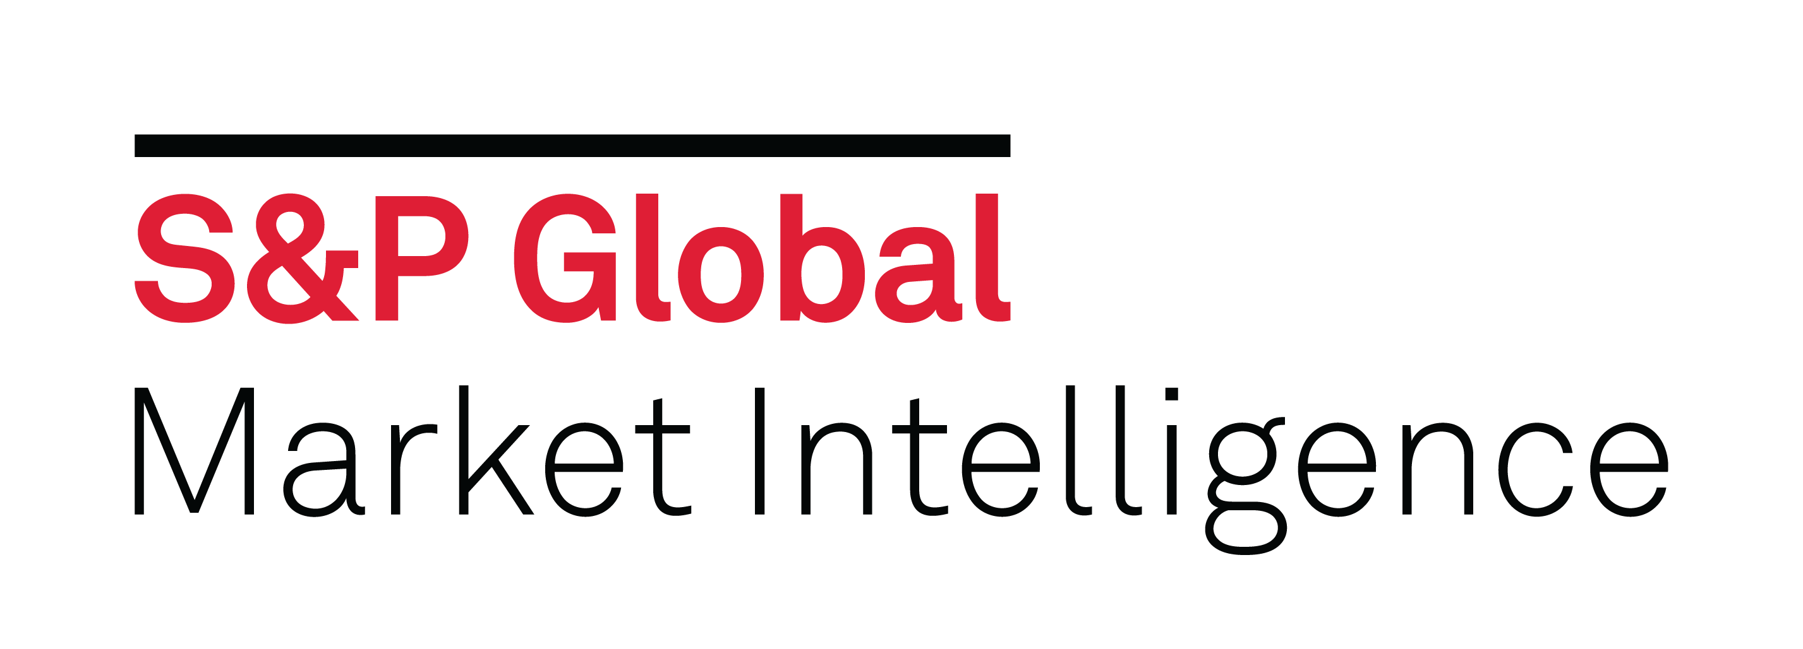

I have been practicing DevOps for over 7 years at three different companies
1999
2015
2019
Retire?
1
2
3
Mid-size
Not-for-profit
Minimal Regulations
2 East Coast Locations
Computerworld’s “Best Places to work in IT”
Quasi-Government
Very Large
For-profit
Heavily Regulated
Multiple US Locations & UK
Fortune 100
25+ years in business
Financial Services Company
Large
For-profit
Regulated and Minimal Regulations
Multiple International Locations
Fortune 500
100+ years in business
Financial Services Company
Notes:
Company 1 is a mid-size, not-for-profit FFRDC. It has been repeatedly named Computerworlds “Best Places to work in IT”. It is where I put in my first pipeline in a Corporate IT department and saw colleagues I cared about get their nights and weekends back when releases became daily and reliable. It’s where I began my career in DevOps.
In 2015 I got the opportunity to bring that experience to more people and I left I was at for 16 years and colleagues I loved to join a much larger transformation effort at a Fortune top 100 company. To say I did a 180 degree turn in my career is an understatement.
And for four years I learned how a transformation-at-scale worked in a heavily regulated, highly competitive industry and environment. I came in with no knowledge of the cloud and very little experience with scaled agile. Four years later I was an Cloud Solutions Architecture, a Director in a large organization, and leading a project-to-product transformations. For four years I got the opportunity to be a part of one of the largest and most progressive digital transformations of our time.
Company 2 was well into their journey and maturing and I decided I wanted to help a company who was at the beginning. In November of 2019 I took an opportunity to join S&P Global and lead in their adoption of DevOps and the Cloud. Today I am Head of DevOps and Cloud in S&Ps Market Intelligence Division.

Slide 3


S&P Global is a technology-enabled data company.
At S&P Global, technology underpins everything we do as we seek to power the markets of the future.
Data, technology, and innovation sit at the center of our strategy.
Data
Technology
Innovation
Use “Data-as-a-Service” to ingest, link, and manage S&P Global’s industry-leading breadth of data
Leverage our cloud-based S&P Global platform as a service for all divisions to build on; develop next-gen enterprise-grade tools and APIs
Embed expertise for emerging technologies across the organization; partner on new opportunities with bleeding-edge firms
Bring new, alternative, and relevant content to market faster, so clients can make decisions with conviction
Accelerate time to market for new products & features to deliver meaningful client value
Enable new product innovation to help clients sharpen their competitive edge
Permission to reprint or distribute any content from this presentation requires the prior written approval of S&P Global Market Intelligence.
Notes:
Most people know S&P for the stock index and ratings. But they also provide energy and commodities data and market insights to support businesses with critical decision making. S&P is primarily a data company with many years and pedabytes of data needing to be accessed and analyzed.

Slide 4

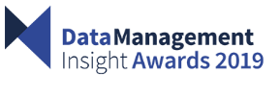
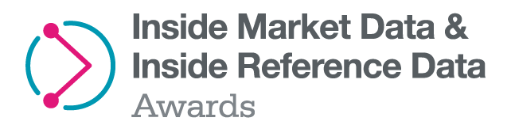

$1.92B division
230K+ active users
11K employees
Stockholm
Moscow
Toronto
London
Frankfurt
Chicago
Halifax
Paris
Milan
Beijing
Denver
Boston
Madrid
Seoul
San Francisco
New York
Dallas
Washington, D.C.
Islamabad
Tokyo
Charlottesville
Gurgaon
Shanghai
Mexico City
Dubai
Hong Kong
Ahmedabad
Manila
Singapore
São Paulo
Johannesburg
Perth
Sydney
Buenos Aires
Melbourne
Best Proposition for AI, Machine Learning, Data Science, 2019
Best Overall Data Provider 2019
Best Data Analytics & Alternative Data Provider 2019
Permission to reprint or distribute any content from this presentation requires the prior written approval of S&P Global Market Intelligence.
Notes:
I work in the S&P Market Intelligence division supporting a web-based platform that supports our customers with the data and analysis they need to make decisions about their finances and businesses with conviction and confidence. Our platform and products are accessed by customers all over the world. My challenge is providing a development and cloud infrastructure system that accelerates the rapid delivery of new and differentiated data sources to our customers in large quantities and distribute it across the globe.

Slide 5


In May, 2020 I held my first All Hands to establish the Mission and Vision for the DevOps & Cloud Engineering Enablement department
We make it convenient for development teams using the SPGI platform to continuously develop, deliver and operate compliant and cost-effective applications at-scale in the cloud
Autonomous teams focused on rapid innovation and delivering value to the customer
Permission to reprint or distribute any content from this presentation requires the prior written approval of S&P Global Market Intelligence.
Notes:
I took the first several months of my new job to listen and learn. I identified who my internal stakeholders and customers were, conducted empathy interviews and learned about the architecture and challenges. I learned about what was important to the organization and formed a mission and vision statement.

Slide 6

CHANGE
CHANGE
?
CHANGE
CHANGE
CHANGE
CHANGE
CHANGE
Notes:
In the all hands I presented this slide. What do you see? I see lots of change, rugged terrain, and a mountain you can’t see past. Like many organizations in the midst of a digital transformation, my organization has been through a lot of change. Changes in technology, leadership and organizational structure. We know and understand that with today’s technology we need to worry about what’s behind that mountain

Slide 7

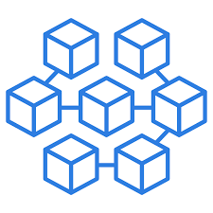
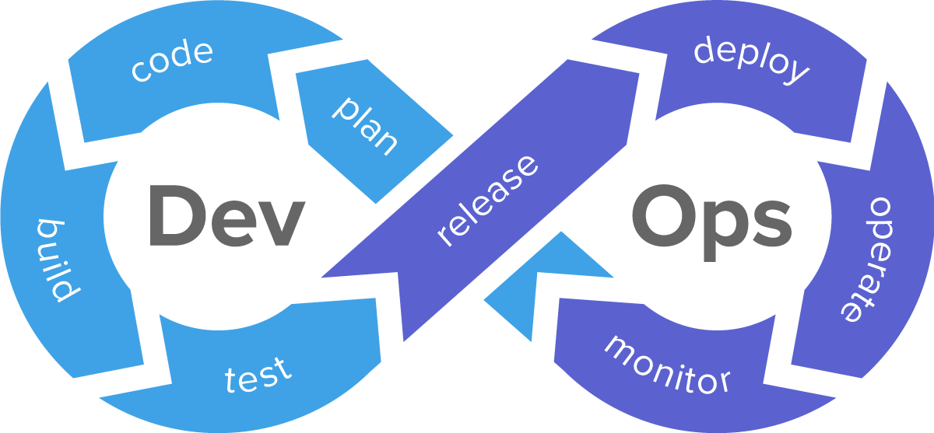
To meet the pace of change we must build systems that are more agile, adaptable, scalable, resilient and tolerant of change
CICD Pipelines
Cloud
Containers & Microservices
S&P Global Market Intelligence Engineering Enablement Platform
Permission to reprint or distribute any content from this presentation requires the prior written approval of S&P Global Market Intelligence.

Slide 8
To meet the pace of change we must build systems be people that are more agile, adaptable, scalable, resilient and tolerant of change
?
?
?
If change is so reliable and something we can always count on then why don’t we take comfort in change?
Fear
Permission to reprint or distribute any content from this presentation requires the prior written approval of S&P Global Market Intelligence.
Notes:
But it’s not enough to build technology to support change, we must be people that can sustain and keep pace with change. The irony of change is that even though it’s so reliable we are still uncomfortable with it. We are still afraid of change. Why is that?

Slide 9
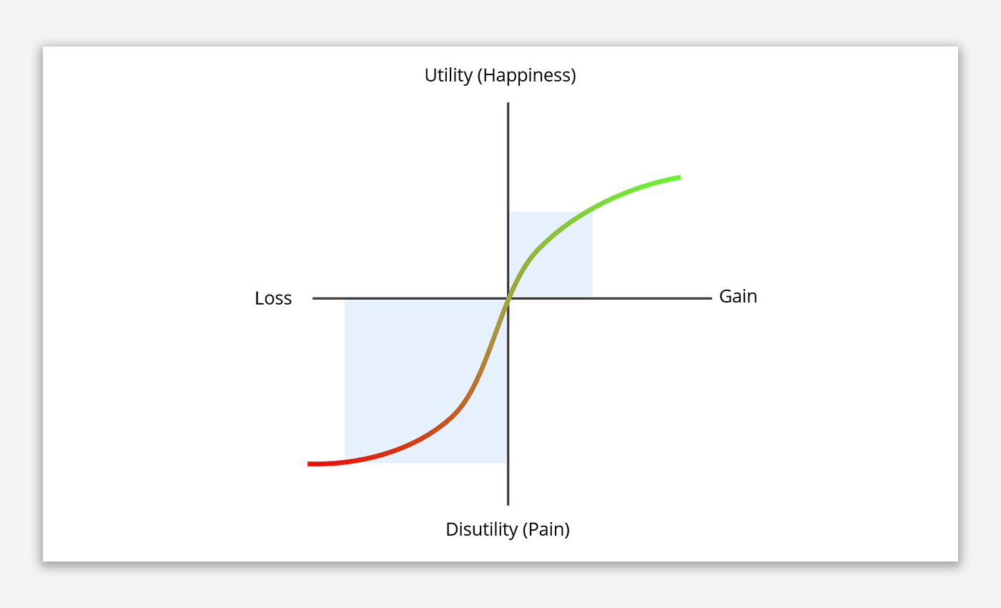
It is my job as a transformational leader to address the fear, embrace the discomfort and loss, and shift the value to be on the gains
With change comes loss and we fear losses more than we value gains
Prospect Theory
It is better not to lose $5 than it is to find $5
People assign too much weight to outcomes with low probability and too little weight to outcomes with high probability
Be comfortable and stagnate or be uncomfortable and grow?
Permission to reprint or distribute any content from this presentation requires the prior written approval of S&P Global Market Intelligence.
Notes:
It’s because we fear losses more than we value the gains. If you’ve read the book “Think Fast Think Slow” you will learn about “Prospect Theory”. That as humans we suffer from loss aversion, that we’d rather not feel the pain of losing $5 more than the joy of finding $5 dollars.

Slide 10
The way I deal with fear is to recognize it, have a plan, listen to my instinct and have a point-of-view
1999
2015
2019
Retire?
1
2
3
Notes:
I made two very significant changes in the last 4 to 5 years after years of no career change. Was I afraid? Very much so. Was I uncomfortable? very much so. But I didn’t let my fear and discomfort didn’t hold me back
The joy of the gains I perceived in my new opportunities exceeded the pain of loss.

Slide 11








I employ a system that enables organizations to help tame the fear and support more comfortable change
The
-Suite
Notes:
I deliberately choose the word “system” rather than framework. My background is as a systems engineer. As a systems engineer I am trained to recognize the components and patterns and how they interrelate to create value and understand the upstream and downstream effects and impact when one of those components is changed.

Slide 12
Establish Cross-Functional Teams
Cross-Functional Teams
Dev + Ops Functions
T-Shaped, Multi-discipline
“You Build It You Own It”
Agile practices
Changing the team structure and potentially the reporting structure is largest source of fear in a DevOps adoption
Notes:
Cross-functional teams are balanced teams whose knowledge and skills covers the entire stack and enables the collective ownership of the application for it’s lifecycle, Cradle-to-grave, code-to-customer.
A cross-functional team where Ops is embedded in the team removes competing incentive structures and the us versus them mentality when Dev and Ops are siloed.
The team cross-skills and everyone learns and grows and the customer wins.

Slide 13
Construct a platform that allows for speed with safety
Construction
Coupling (loose) - Microservices
Everything is code
CI/CD Pipeline Automation
Cloud, Containers, Configuration Automation (Orchestration)
Cyber and Compliance Obsessed
Chaos Testing
Inner-sourced, self-service, “X-as-a-service”
Cross-Functional Teams
Dev + Ops Functions
Full Stack Teams
“You Build It You Own It”
Agile Practices
Notes:
No Fear Releases. Enable reliable, predictable, high quality releases of value into a scalable, resilient, high performing and highly available cloud
Provide reusable code libraries and codified stacks that meet compliance and security requirements so your engineers aren’t in fear of Audit and Infosec
Invest in refactoring code into microservices for applications you are invested in for the long-term.

Slide 14
Practice Continuous Feedback, Flow & Improvement
Continuous Feedback and Flow
Continuously Integrating
Continuously Delivering
Continuously Operating
Continuously Improving (Metrics & Measurement)
Construction
Coupling (loose) – Microservices
Everything is code
CI/CD Pipeline
Cloud, Containers, Configuration Automation (Orchestration)
Cyber and Compliance Obsessed
Chaos Testing
Inner-sourced, self-service
Cross-Functional Teams
Dev + Ops
Full Stack Teams
“You Build It You Own It”
Agile Practices
Notes:
Drive the engineering practices for continuous feedback and flow. Implement an “Engineering Excellence Program”. It will improve developer engagement , raise motivation, and positively impact quality and time to value. Make these practices measured, visible in a dashboard so they can measure their progress. Drive them to compete against themselves in improving. Think of it like a swim team that is continually striving to drop time from their last swim.

Slide 15
Establish a Competency Center
Continuous
Continuously Integrating
Continuously Delivering
Continuously Operating
Continuously Improving (Metrics & Measurement)
Construction
Coupling (loose) - Microservices
Everything is code
CI/CD Pipeline
Cloud, Containers, Configuration Automation (Orchestration)
Cyber and Compliance Obsessed
Chaos Testing
Inner-sourced, self-service
Competency Center
Continuous, Accelerated Learning
Capabilities Model
Curriculum
Coaching
Curiosity (R&D)
Cross-Functional Teams
Dev + Ops
Full Stack Teams
“You Build It You Own It”
Agile Practices
Notes:
I like to call this the “No Fear” center. Nothing says “we are here to help you” and we want you to be successful more than a competency center staffed with highly skilled masters to coach teams and individuals adopt new ways of working and new skills. In the CoC teams can co-create and innovate and accelerate their learning.
What I have seen be the most successful in shepherding teams through change is the Immersive learning, or Dojo model, where teams collocate with coaches and dedicate an extended period of time to adopting the tools and practices. It’s where they go to learn in a psychologically safe environment and where it is safe to fail

Slide 16
Build an Internal Community
Continuous
Continuously Integrating
Continuously Delivering
Continuously Operating
Continuously Improving (Metrics & Measurement)
Construction
Coupling (loose) - Microservices
Everything is Code
CI/CD Pipeline
Cloud, Containers, Configuration Automation (Orchestration)
Cyber and Compliance Obsessed
Chaos Testing
Inner-sourced, self-service
Competency Center
Continuous, Accelerated Learning
Capabilities Model
Curriculum
Coaching
Curiosity (R&D)
Cross-Functional Teams
Dev + Ops
Full Stack Teams
“You Build It You Own It”
Agile Practices
Community Building
Tech Exchanges/Meetups
DevOps Days
Hack-a-thons
Gamification
Notes:
The 2019 State of DevOps reports states that “high performers favor strategies that create community structures at both high and low levels in the organization, including CoPs, making transformations more sustainable and resilient to reorgs and product changes” It is the Communities that will help scale transformations.
Hack-a-thons are effective a jump starting innovation and problem solving. I’ve seen solutions from hack-a-thons solve complex problems that couldn’t be solved by experts in a room for two days.
Gamification, some peer pressure and healthy competition go a long way

Slide 17
Communicate success frequently and loudly
Continuous
Continuously Integrating
Continuously Delivering
Continuously Operating
Continuously Improving (Metrics & Measurement)
Construction
Coupling (loose) - Microservices
Everything is Code
CI/CD Pipeline
Cloud, Containers, Configuration Automation (Orchestration)
Cyber and Compliance Obsessed
Chaos Testing
Inner-sourced, self-service
Competency Center
Continuous, Accelerated Learning
Capabilities Model
Curriculum
Coaching
Curiosity (R&D)
Cross-Functional Teams
Dev + Ops
Full Stack Teams
“You Build It You Own It”
Agile Practices
Community Building
Tech Exchanges/Meetups
DevOps Days
Hack-a-thons
Gamification
Communications
Blog posts
Newsletters
Story Telling and Sharing
Rewards and Recognition
Notes:
Provide the people with a platform to shout their success from the mountain tops. Use leadership to communicate and repeat the message and the mission over and over again at town halls. The more stories are told and the more emphasis leadership share the more people will accept that this is here and here to stay. that acceptance and sense of conviction from their peers and leadership will provide a sense of security and stability they are longing for in a changing environment.

Slide 18
Tie results to Customer-focused outcomes
Continuous
Continuously Integrating
Continuously Delivering
Continuously Operating
Continuously Improving (Metrics & Measurement)
Construction
Coupling (loose) - Microservices
Everything is Code
CI/CD Pipeline
Cloud, Containers, Configuration Automation (Orchestration)
Cyber and Compliance Obsessed
Chaos Testing
Inner-sourced, self-service
Competency Center
Continuous Learning
Capabilities Model
Curriculum
Coaching
Curiosity (R&D)
Cross-Functional Teams
Dev + Ops
Full Stack Teams
“You Build It You Own It”
Agile Practices
Community Building
Tech Exchanges/Meetups
DevOps Days
Hack-a-thons
Gamification
Customer-Focused Outcomes
Net Promoter Score (NPS)
Revenue & Retention Rate
Time-to-Value
Leading Indicators
Communications
Blog posts
Newsletters
Story Telling and Sharing
Rewards and Recognition
Notes:
Measure value and results and show the data that supports what you are doing is working. Tie DevOps results to business results and avoid the vanity metrics that show productivity but probably not progress. When employees see the difference they are making in numbers and data they will want to do more and go above-and-beyond. They will know this is working.

Slide 19
Demonstrate the DevOps Culture
Continuous
Continuously Integrating
Continuously Delivering
Continuously Operating
Continuously Improving (Metrics & Measurement)
Construction
Coupling (loose) - Microservices
Everything is Code
CI/CD Pipeline
Cloud, Containers, Configuration Automation (Orchestration)
Cyber and Compliance Obsessed
Chaos Testing
Inner-sourced, self-service
Competency Center
Continuous, Accelerated Learning
Capabilities Model
Curriculum
Coaching
Curiosity (R&D)
CULTURE
Openness
Ownership
Experimental
Embrace Failure
Fail Fast
Psychological
Safety
Cross-Functional Teams
Dev + Ops
Full Stack Teams
“You Build It You Own It”
Agile Practices
Community Building
Tech Exchanges/Meetups
DevOps Days
Hack-a-thons
Gamification
Customer-Focused Outcomes
Net Promoter Score (NPS)
Revenue & Retention Rate
Time-to-Value
Leading Indicators
Communications
Blog posts
Newsletters
Story Telling and Sharing
Notes:
Finally, in the middle, at the heart of the c-suite and the most critical element to taming fear is culture. Creating an environment where failure is celebrated as part of learning, where people feel accountable and ownership, that it’s safe to speak up and challenge status quo. This will give them comfort and conviction in this journey that erodes at the fear. As part of changing culture validate to people that this scary and that it is normal to be afraid. There’s a concept of “name it to tame it”. That once you name the emotion the emotion will inform you and not overwhelm you.

Slide 20
The components work together to form a flywheel for driving to self-sufficient, YBYO teams…
Improve Business Results
Cross-functional DevOps Team is Formed
Monitor & Measure Results
App is deployed to and operated on platform
Self-service to on-demand codified resources & references
Develop using Agile, TDD, CI/CD,
practice
Continuous Improvement
Accesses Resources & Get Support From Competency Center
Communicate, Demo & Share Results & Code
With Community
Notes:
I like to use a technique called a “fly wheel” that tests my strategy and how the components of the c-suite work together to drive momentum for change and moving towards the mission. I use this with my internal customers and stakeholders to give them an idea on how this system will build the momentum for transformation. It works like this.

Slide 21
And the DevOps dream can be realized
My DevOps Success Criteria is when 100% of Customer Facing “Invest In” Products Have
1
Collective ownership between Dev and Ops for for the quality, reliability, availability and performance of the software product for it’s full lifecycle
2
Rapid experimentation and releases of high quality software at any pace and any time
without disruption to the customer
3
Restore the entire application and its environment with a single command

Slide 22
And support establishing work streams and a roadmap to execute on
CI Pipeline
CD Pipeline,
Infr. Automation &
Basic Monitoring
Containers &
Orchestration, App Monitoring
Microservices & Service Mesh, Cloud Native
Serverless, FaaS,
Predictive Monitoring,
Auto Failure Testing
Cloud Migration
Agile Coaches
Individual Training
Technical Coaches, Team-based Training
Immersions, Code Library, Refactoring Support
Dojo & Accelerators
Self-Service
Value Stream w/ Full-Stack
Product Teams Pilot
Value Streams & Product Teams
Fully Operational
Cross-Skilling
YBYO, Rotating Support
Autonomous, Rapid Innovation
Agile Development
Continuous Integration
TDD and
Continuous Improvement
Trunkbased Dev,
Continuous Delivery,
Blue-Green
Continuous Deployment, Canary Releases
Continuous Operations, A/B Testing
Capture Data
Baseline
Benchmark
Correlated
Data-driven
Decisions
Community of Practice
Hack-a-thon & Webinars
Gamification
Host Internal Conference
Host External Conference
Share a Success Story
Rewards & Recognition
Tell others our Story
Others tell our story
Declare Journey
Notes:
I continue to use the components of the c-suite to establish the workstreams and a roadmap that shows the path forward and how will organize around the work for execution. This helps to make the strategy executable and establishes milestones and capabilities they can track progress against. I mentioned earlier that having a plan and a path forward helped to ease my fear and anxiety over my career changes, having a roadmap and way to show how to organize and execute will do the same for those going through this change

Slide 23
Over time, as the virtuous cycle of continuous improvement and competency perpetuates, the lines fade between Dev and Ops
Ops
Ops
Ops
Ops
Ops
Ops
Ops
Ops
Ops
Ops
Ops
Ops
Ops
Ops
Ops
Ops
Ops
Ops
Ops
Ops
Ops
Start
Phase I
Phase II
Phase III

Slide 24
Each organization has a unique change profile that that influences their motivation and absorption rate of change
Changeability Factor | 1 | 2 | 3
Competitive Environment, Disruption Factor | Low | High | Medium
Tolerance for Risk | Low | High | Medium
System Complexity, Legacy | Medium | Medium | High
Organization Size | Low | High | Medium
Geographically Distributed | Low | Medium | High
Organizational Stability, Change Frequency | Low | Low | Medium
Exec Leadership Stability & Support | High | High | Low
 | >10 years | 3-5 years | 3-5 years
Notes:
Everyone of these companies want what DevOps has to offer, but just like people there are personalities and profiles that impact the rate and success of that adoption. They will get there but in their own time, but will it be fast enough?
Notice company two. It was the biggest and most aggressive of the three and yet it was at least 3 years before they really saw the benefits of DevOps to the business and could get a greenfield product out the door in less than 3 months

Slide 25

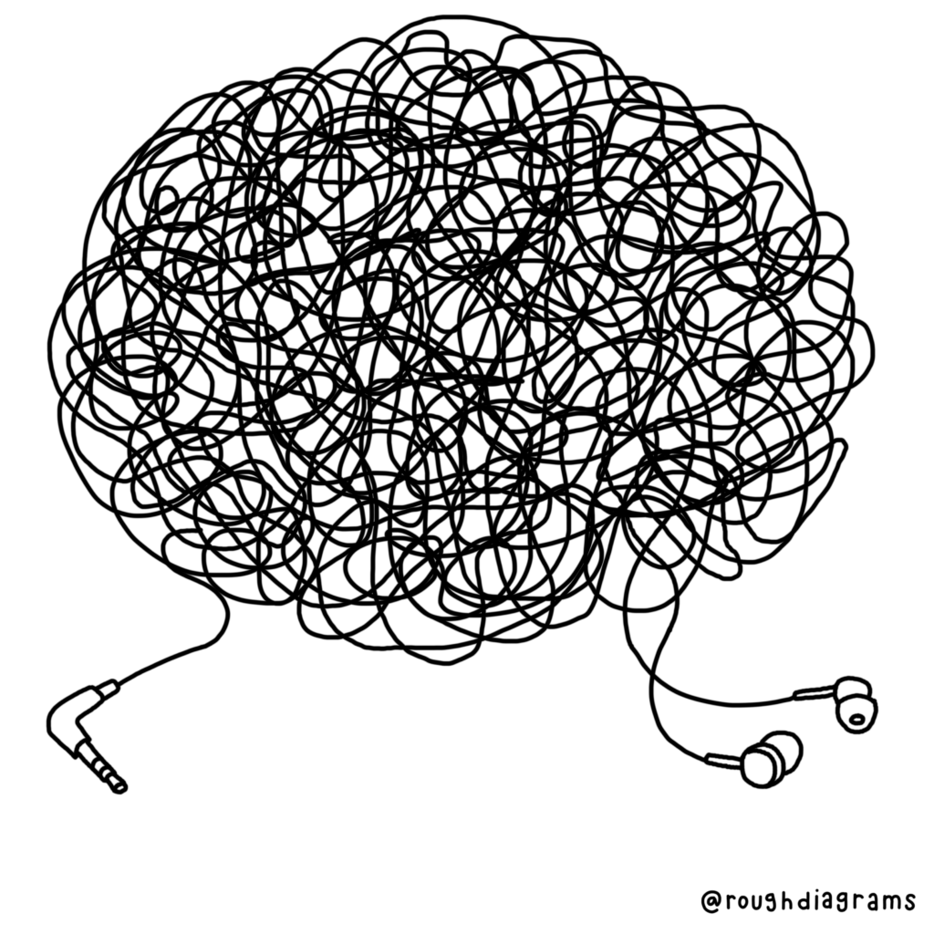
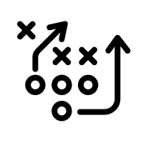
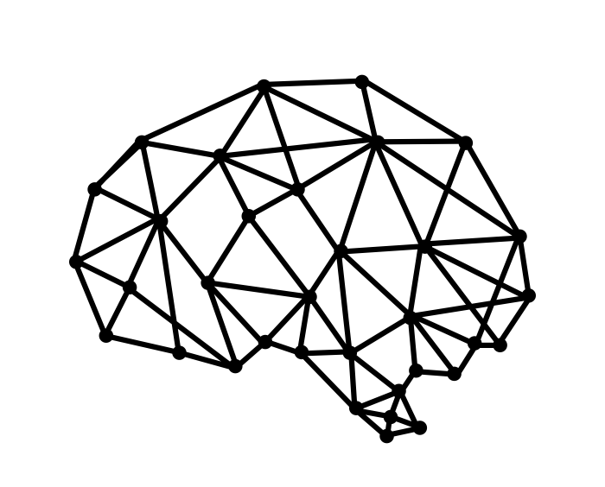


There are circumstances that will make DevOps adoption harder than it needs to be no matter who or what the organization is
!
Too much change
Complex, undocumented legacy systems
Organization & Leadership
Changes
Cognitive Overload
This is NORMAL and you will need to inspect and adapt and adjust your expectations and timeline
Notes:
No matter the company’s size and motivation

Slide 26
To meet the pace of change we must build systems be people that are more agile, adaptable, scalable, resilient and tolerant of change
?
?
?
If change is so reliable and something we can always count on then why don’t we take comfort in change?
Fear
Permission to reprint or distribute any content from this presentation requires the prior written approval of S&P Global Market Intelligence.
Notes:
I have shared with you my strategy and method for structuring a transformation that provides organizations with the method, components, roadmap that provides a path forward to a DevOps adoption that gives them the confidence to take on such a large and ambitious journey. At this point I want to revisit the question of being people that are more agile, adaptable, scalable and tolerant of change and see if we can pop answers into these circles

Slide 27
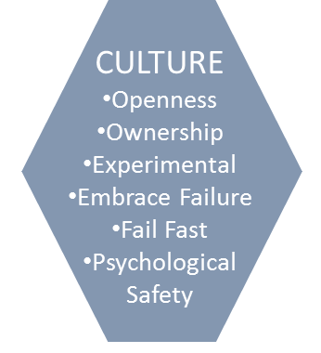
If you give people a path forward in a system designed to enable them for agility, adaptability, scalability, resilience and tolerance of failure…
People to Help
A Platform to Accelerate and Deliver Value Safely
Leadership Showcasing and Changing Culture
You will tame the fear that holds you back!
Permission to reprint or distribute any content from this presentation requires the prior written approval of S&P Global Market Intelligence.
Notes:
I believe that it would have

Slide 28
CHANGE
CHANGE
?
CHANGE
CHANGE
CHANGE
CHANGE
CHANGE

Slide 29


Slide 30
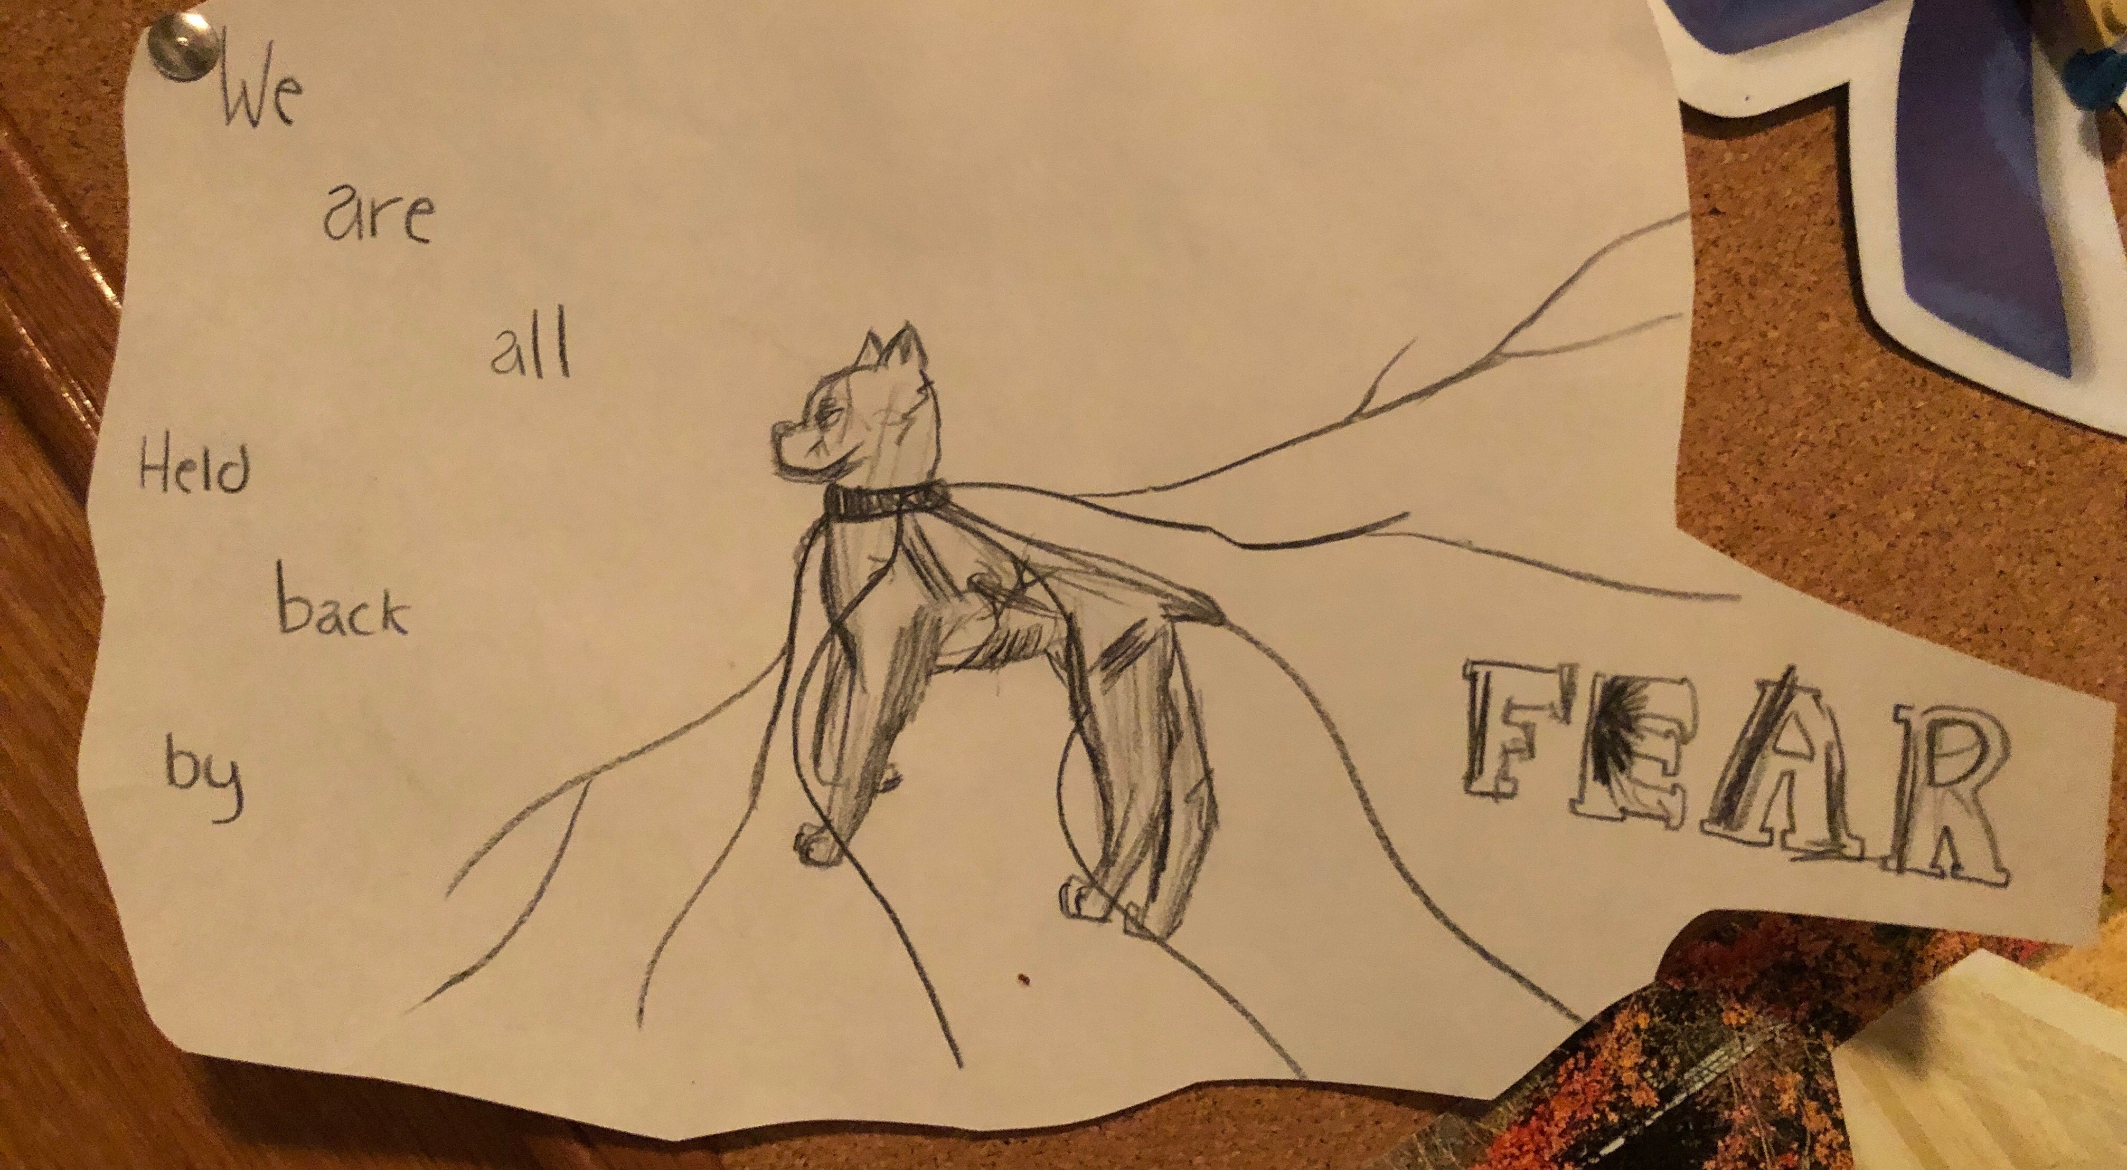

Slide 31
THANK YOU!

